Slide 1

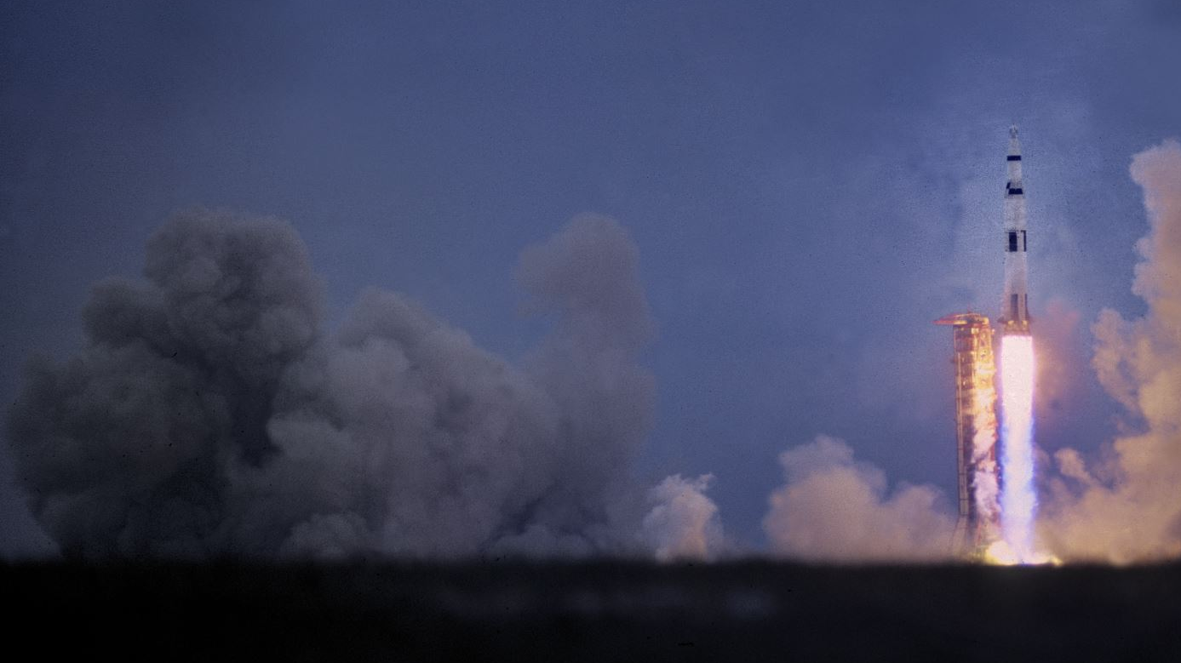
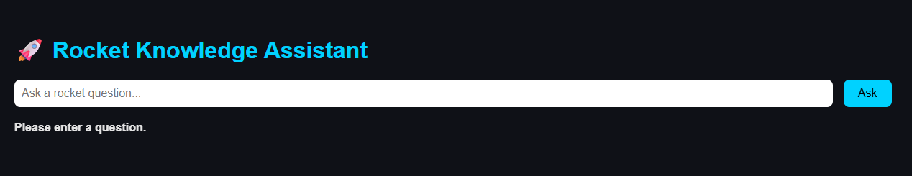
Rocket Knowledge Assistant
“Ask a rocket question. Get an instant answer.”
Notes:
“Hi everyone, what we have here is called the Rocket Knowledge Assistant. It's a chatbot designed to answer questions about space and rocket science instantly. Whether you’re curious about rocket launches, specific missions, or reusable vehicles, just ask—and get an answer right away.
It is user-friendly, perfect for anyone to use.”

Slide 2



A chatbot that answers space and rocket questions instantly.
🧑‍🚀 Ask about rocket launches, missions, and reusable vehicles
📊 Pulls facts from a real database
🤖 Uses AI (ChatGPT) for complex questions
Rocket Knowledge Assistant
Group 3
What it does
Why it Matters
How it Works
Notes:
“This chatbot works by combining three powerful tools: Python, SQLite, and OpenAI.
First, users can ask about launches, missions, or space vehicles.
It then pulls real data from a structured database,
And for more complex questions, it uses AI—to provide smart, helpful answers.

Slide 3
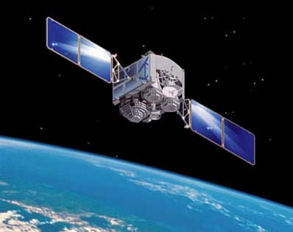
Rocket science doesn’t need to be intimidating.
🌍 Makes space facts accessible to anyone
🧒 Great for students, enthusiasts, or casual learners
⚡ Fast, reliable, and fun to use
"Turning complex science into everyday curiosity."
Rocket Knowledge Assistant
Group 3
What it does
Why it Matters
How it Works
Notes:
“Rocket science can feel intimidating, but we wanted to change that.
This tool makes space facts easy to access,
It’s perfect for students, science fans, or anyone interested in space.
And most of all, it’s fast, reliable, and fun. We believe science should be about curiosity, and this project turns complex information into everyday learning.”
Helps users explore space-related data interactively.
Supports education, research, and public outreach.

Slide 4
Under the hood, it’s a smart system that knows when to search and when to think.
💬 User types question
🧠 Intent detected — database vs. AI
📚 Answer pulled from mission data
🤖 Or AI generates response if needed
Rocket Knowledge Assistant
Group 3
What it does
Why it Matters
How it Works
Notes:
“Under the hood, it’s a smart system. When a user types a question, it first detects the intent—is this something from the database, or does it need an AI-generated answer?
If it’s factual—like a launch date—it pulls data from the mission database.
If it’s more open-ended—like ‘Why are rockets reusable?’—ChatGPT generates a helpful explanation.
It’s a smooth mix of structured facts and intelligent reasoning.”
🧠 System detects whether to search the database or use AI"

Slide 5
Demo Time
Rocket Knowledge Assistant
Group 3

